Slide 1


UNIVERSIDAD AUTÓNOMA DEL ESTADO DE HIDALGO
ESCUELA SUPERIOR DE ZIMAPÁN
Licenciatura en Derecho
Tema:expresar sentimientos personales
L.E.L.I. Maria del Rosario Nolasquez Trejo
Enero-Junio 2016

Slide 2
Tema: expresar sentimientos personales.
Resumen (Abstract)
Estudiaremos adejetivos con terminación –ing/ --ed
We are going to study adjectives with –ing / --ed
Palabras clave: (keywords)
--ing adjectives
--ed adjectives

Slide 3
Objetivo general: El alumno podrá expresar y fundamentar acuerdos y desacuerdos, realizar invitaciones así como aceptar o rechazar las realizadas por terceros. Asimismo, podrá expresar preferencias, obligaciones y necesidades.

Slide 4
Nombre de la unidad: Expresar acuerdos, desacuerdos y sentimientos personales.
Objetivo de la unidad: Expresar opiniones sobre temas diversos, enfatizando si se está de acuerdo o no y que sentimientos provoca tal situación.

Slide 5
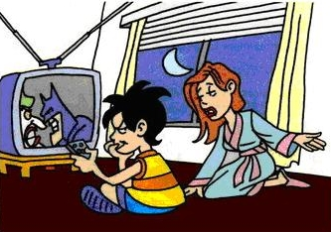

--ed and –ing adjectives
We use –ed adjectives to describe how people feel.
Example: Many people are worried about how much TV children watch.
Example: Were you surprised by anything in the artcle?

Slide 6


Desarrollo del tema:
We use –ing adjectives to describe the things, situation, place or person that causes the feeling.
Example: TV can sometimes be fun and exciting.
Example: this is a worrying article.

Slide 7
Practice with these sentences
I. Choose the correct words.
1 Which TV programmes do you think are bored/boring?
2 What’s the most frightened / frightening film you’ve ever seen?
3 When was the last time you were really tired / tiring ?
4 What’s the most excited / exciting holiday you’ve ever had?
5 What are you interested / interesting in ?

Slide 8
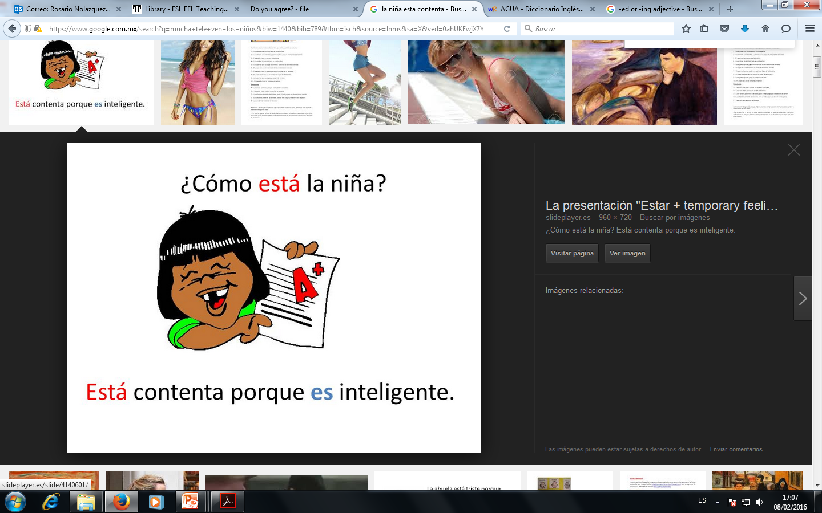


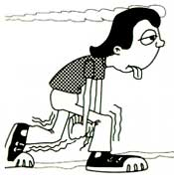
Conclusión o cierre:
TIP! People can be bored or boring and interested or interesting.
She’s excited. She’s surprised.
He’s worried. He’s tired.

Slide 9
Bibliografía del tema:
Redston, C. y Cunningham, G. (2005). Face2face Elementary Student’s Book. Italy: Cambridge.
Murphy, Raymond. (2001). English Grammar In use. Great Britain:Cambridge University Press.

